Slide 1
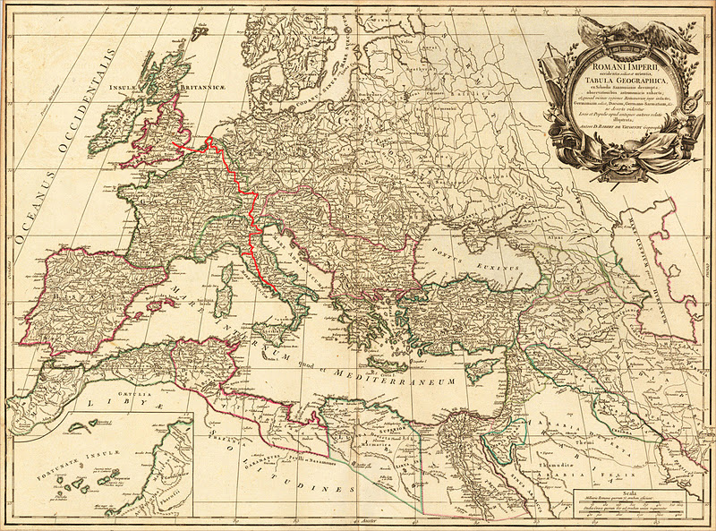
Italian Tourism 1650-1850 also known as
The Grand Tour
By Joshua Mei

Slide 2
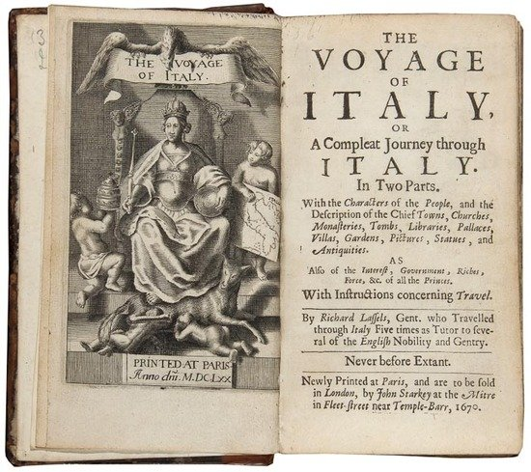
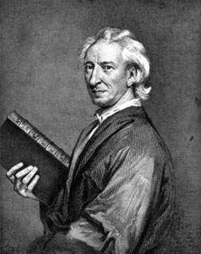
How the Grand Tour Began
Idea of Grand Tour began in the mid 17th century
Initially was mobile finishing school in art and manners
Popularized by travel writers such as John Evelyn andRichard Lassels (Voyage of Italy)
The Voyage of Italy by Richard Lassels (Left)
Portrait of John Evelyn (Right)

Slide 3
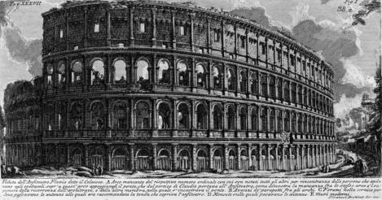
Significance of The Grand Tour
First form and development of the travel industry
Many wealthy young men from England studied abroad for educational purposes.
Influence of ideas and concepts of the Classic shaped new culture and architecture in Britain.

Slide 4
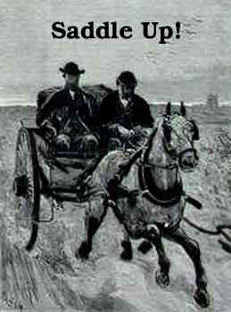
Preparations
War and Crime
Dangers
Cost and Finance
Guidelines
What to pack

Slide 5
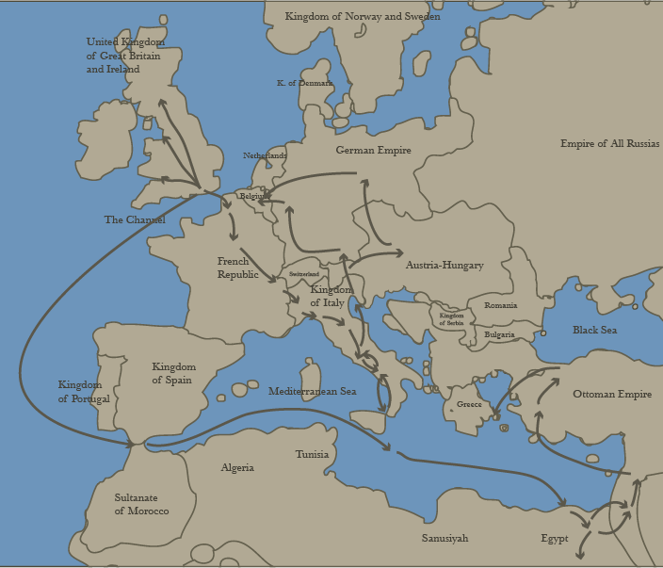
Mapping the Grand Tour
The Italian Peninsula was the primary destination for the Grand Tourist. Some of the most visited cities are Venice, Naples and Rome.
Lady Montgu’s Social Network in Italy
Riedesel’s Journey Through Sicily
Watkins’ Impression of people
Rutherford’s Travel Guide

Slide 6
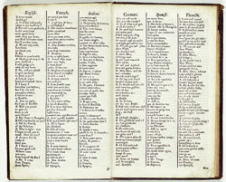
The Three Views of the Grand Tour
View 1: Parent’s fear of abandoning own religion and culture.
View 2: Young man’s excitement and fascination about the tour.
View 3: Guidebook for those undertaking the tour.
Link: http://wwnorton.com/college/english/nael/18century/topic_4/tour.htm
Guidebook showing the dialogues of English, French, Italian, German, Spanish and Flemish conversations with a landlord at Italy (left).

Slide 7
Interesting Facts about the Grand Tour
Though the tour is regarded as a literary endeavor, there were many that set on this journey for pure tourism.
Mary Wollstonecraft was also a participant of the Grand Tour. Though her daughter Mary Shelley along with Percy Shelley did not go to Italy, they were also participants of the tour in other places of the European Continent. On the tour Mary Shelley got the idea of writing Frankenstein.

Slide 8
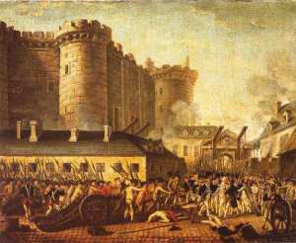
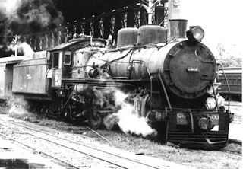
The Fall of the Grand Tour
The French Revolution in 1789 marked the end of the Grand Tour for in the early nineteenth century, railroads totally changed the face of tourism and travel across the continent.

Slide 9
Pop Quiz
1. True or False
(T) (F) John Evelyn wrote Voyage of Italy

Slide 10
Pop Quiz
2. Multiple Choice
Which of the following(s) had the Grand Tour shaped in England? Choose all that apply.
(A)Architecture (B) Culture
(C)Economy (D) All of the above
(E) A and B

Slide 11
Pop Quiz
3. DBQ
Just Kidding!...... Not really

Slide 12
Works Cited
Alberto, Carlos et al. “Railways.” Work English 3. 18 April 2011. Web. 17 March 2014.
“British Grand Tour in the 18th Century.” The Grand Tour Art and Travel. Indiana University Art Museum. Web. 17 March 2014.
Carol, Alan. “Mission Possible: Italian Grand Tour.” Surface Fragments. 6 December 2011. Web. 17 March 2014.
Ceserani, Giovanna, et al. “Mapping the Grand Tour.” Stanford University Department of Classics. Stanford University. 2011. Web. 17 March 2014.
Desmond, Geoffrey. “Title page of Richard Lassels’ book.” Pictify. 7 February 2013. Web. 17 March 2014.
Doyle, Marissa, and Regina Scott. “Being a Teen in the Nineteenth Century.” Nineteen Teen. 24 August 2012. Web. 17 March 2014.
Graves, Dan. “Evelyn’s Diary, Window on an Age and a Soul.” Christianity. May 2007. Web. 17 March 2014.
Gross, Matt. “What is the Grand Tour?” Frugal Traveler. The New York Times. 14 May 2008. Web. 17 March 2014.
Kusuma, Sarita, et al. “Preparations.” Grand Tour Tourism. University of Michigan. Web. 17 March 2014.
“Revolutions-now and 1789.” Talk and Politics. 22 October 2011. Web. 17 March 2014.
Rosenberg, Matt. “Grand Tour of Europe.” About Education. Web. 17 March 2014.
“Three Views of the Grand Tour.” Norton Anthology of English Literature. Web. 17 March 2014.
Tice, Jim, et al. “18th Century Rome and the Grand Tour.” Imago Urbis: Giuseppe Vasi’s Grand Tour of Rome. University of Oregon. 2008. Web. 17 March 2014.

Slide 13
Epic Fail!
You did not survive European History.
Retry?

